Slide 1
Laplace Transform Analysis
Linear Circuit Analysis II
EECE 202 – Spring 2025

Slide 2
Announcement
Project Groups should be complete
Quiz during Week 4
GCA1 during Week 5

Slide 3
Recap
Laplace Transform Analysis
New Material
Proper and Improper Rational Functions
Inverse Laplace Transforms
Differential Property

Slide 4
Learning Outcomes
2. an ability to compute responses of linear circuits with and without initial conditions via one-sided Laplace transform techniques. SO [1]

Slide 5
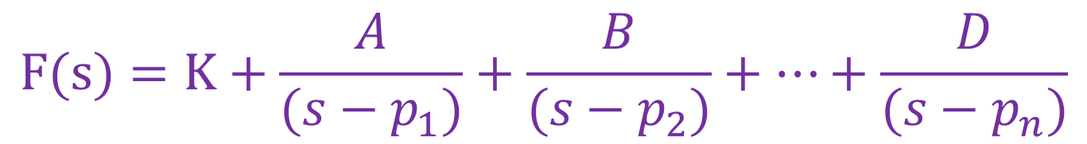
Partial Fraction Expansions
1. Distinct Poles
F(s) = $\frac{{a_{m}s}^{m}{{+a}_{m−1}s}^{m−1}+…{{+a}_{1}s}^{1}{+a}_{0}}{{s^{n}{+b}_{n−1}s}^{n−1}{{+…b}_{1}s}^{1}{+b}_{0}}$ =$\frac{{a_{m}s}^{m}{{+a}_{m−1}s}^{m−1}+…{{+a}_{1}s}^{1}{+a}_{0}}{\left(s−p_{1}\right)\left(s−p_{2}\right)…(s−p_{n})}$
p₁, p₂,……….. p_{n} are the zeros of the denominator polynomial
If F(s) is a proper rational function with distinct (simple) poles, p1, … , pn.
The partial fraction expansion can be represented as:
$$F(s)=K+\frac{A}{(s−p_{1})}+\frac{B}{(s−p_{2})}+…+\frac{D}{(s−p_{n})}$$
For m≤n

Slide 6

Partial Fraction Expansions
where
$K=\lim_{s→∞}\left(F(s)\right)$ (note: K=0 when m<n)
$$A=\lim_{s→p_{1}}\left((s−p_{1})F(s)\right)$$
$$B=\lim_{s→p_{2}}\left((s−p_{2})F(s)\right)$$
.
.
.
$$D=\lim_{s→p_{n}}\left((s−p_{n})F(s)\right)$$

Slide 7
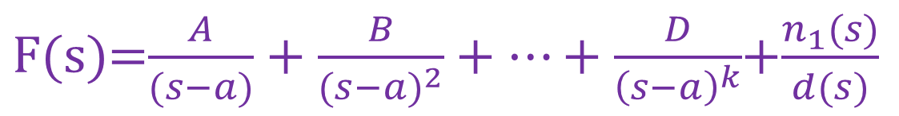
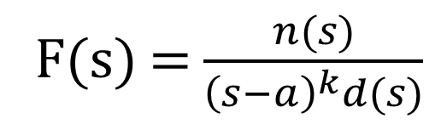
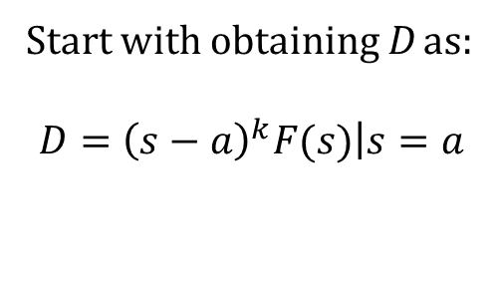

Partial Fraction Expansions
2. Repeated Poles
F(s) = $\frac{n(s)}{{\left(s−a\right)}^{k}d(s)}$
${\left(s−a\right)}^{k}$ specifies a repeated root of order k
$\text{F}\text{(}\text{s}\text{)}$=$\frac{A}{(s−a)}+\frac{B}{{(s−a)}^{2}}+…+\frac{D}{{\left(s−a\right)}^{k}}$+$\frac{n_{1}(s)}{d(s)}$
$n_{1}(s)$ and d(s) are whatever remains in the partial fraction expansion of F(s)
Start with obtaining D as:
$$D={\left(s−a\right)}^{k}F(s)\left|s=a\right.$$

Slide 8
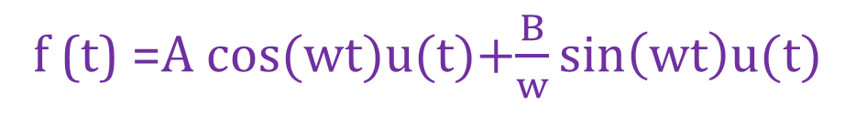
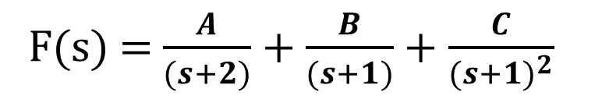
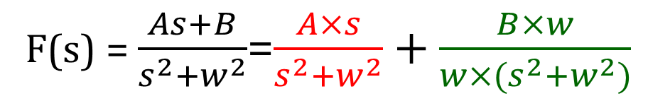
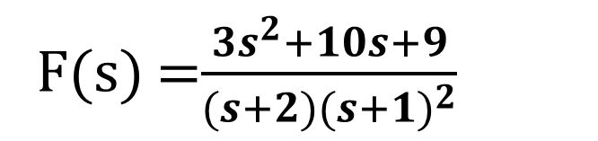
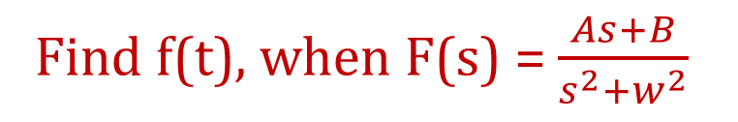

Exercise (p. 571)
F(s) =$\frac{{3s}^{2}+10s+9}{(s+2){(s+1)}^{2}}$
Find f(t) for the following function
F(s) = $\frac{A}{(s+2)}+\frac{B}{(s+1)}+\frac{C}{{(s+1)}^{2}}$
$$A= 1, B=2, C=2$$
$$f\left(t\right)=e^{−2t}u\left(t\right)+2e^{−t}u\left(t\right)+2e^{−t}r\left(t\right)$$
Example 1
Find f(t), when F(s) = $\frac{As+B}{s^{2}+w^{2}}$
F(s) = $\frac{As+B}{s^{2}+w^{2}}$=$\frac{A×s}{s^{2}+w^{2}}+\frac{B×w}{w×(s^{2}+w^{2})}$
f (t) =A cos(wt)u(t)+$\frac{B}{w}\sin\left(wt\right)u(t)$

Slide 9
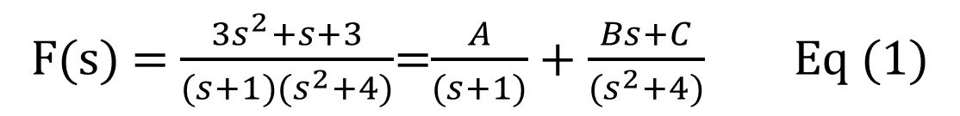
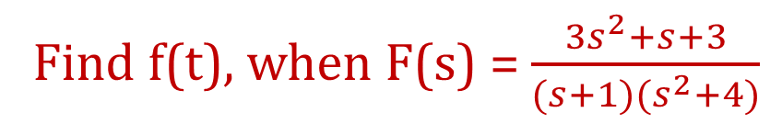
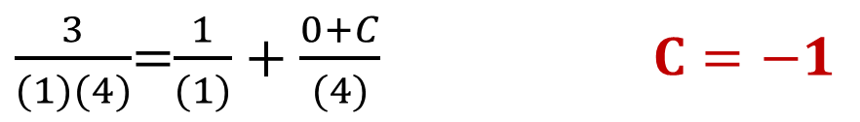
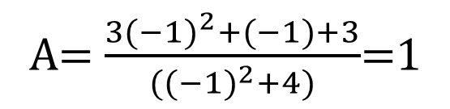
Example 12.16 (p. 574)
Find f(t), when F(s) = $\frac{{3s}^{2}+s+3}{(s+1)(s^{2}+4)}$
F(s) = $\frac{{3s}^{2}+s+3}{(s+1)(s^{2}+4)}$=$\frac{A}{(s+1)}+\frac{Bs+C}{(s^{2}+4)}$ Eq (1)
A= $\frac{{3(−1)}^{2}+(−1)+3}{({(−1)}^{2}+4)}$=1
Determine C, use s = 0 in Eq(1) to get rid of B
$\frac{3}{(1)(4)}$=$\frac{1}{(1)}+\frac{0+C}{(4)} C=−1$

Slide 10
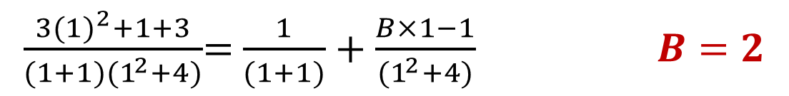
Determine B, use s=1
$\frac{{3(1)}^{2}+1+3}{(1+1)(1^{2}+4)}$= $\frac{1}{(1+1)}+\frac{B×1−1}{(1^{2}+4)} B=2$
F(s) = $\frac{{3s}^{2}+s+3}{(s+1)(s^{2}+4)}$=$\frac{1}{(s+1)}+\frac{2s−1}{(s^{2}+4)}$=$\frac{1}{(s+1)}+\frac{2s}{(s^{2}+2^{2})}−\frac{0.5×2}{(s^{2}+2^{2})}$
$$f(t) = e^{−t} u(t)+2cos⁡(2t)u(t)−0.5sin⁡(2t)u(t)$$

Slide 11
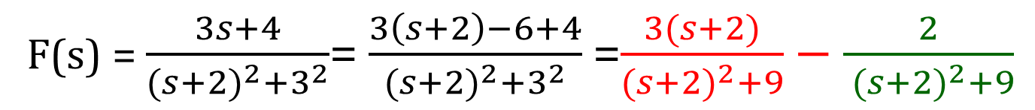
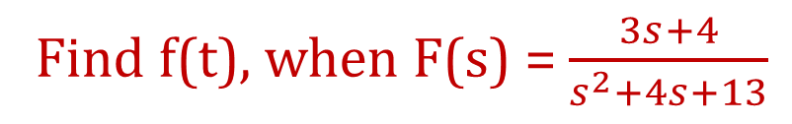
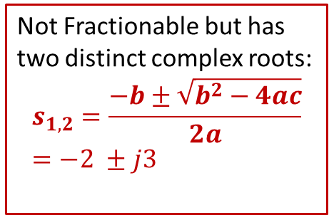
Example 2
Not Fractionable but has two distinct complex roots:
$$s_{1,2}=\frac{−b±\sqrt{b^{2}−4ac}}{2a}=−2 ±j3$$
Find f(t), when F(s) = $\frac{3s+4}{s^{2}+4s+13}$
F(s) = $\frac{3s+4}{{(s+2)}^{2}+3^{2}}$= $\frac{3\left(s+2\right)−6+4}{{(s+2)}^{2}+3^{2}}$=$\frac{3(s+2)}{{(s+2)}^{2}+9}−\frac{2}{ ({s+2)}^{2}+9}$
$f (t) =3e^{−2t}$ $cos⁡(3t)u(t) − \frac{2}{3}e^{−2t}sin\left(3t\right)u(t)$

Slide 12
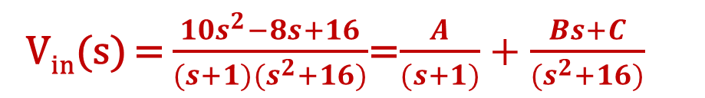
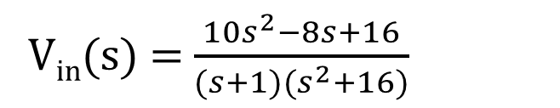
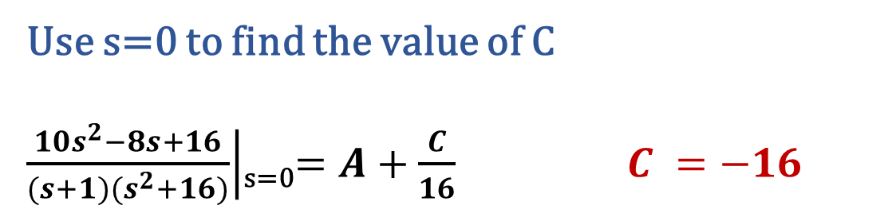
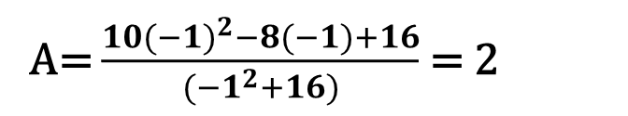
Example 3
Find V_{out} (s) and V_{out} (t) for the following Circuit
V_{in}(s) = $\frac{{10s}^{2}−8s+16}{(s+1)(s^{2}+16)}$
V_{in}(s) = $\frac{{10s}^{2}−8s+16}{(s+1)(s^{2}+16)}$=$\frac{A}{(s+1)}+\frac{Bs+C}{(s^{2}+16)}$
2Ω
+
A= $\frac{{10(−1)}^{2}−8(−1)+16}{({−1}^{2}+16)}$ = 2
+
8Ω
V_{out}
V_{in}
-
-
Use s=0 to find the value of C
$\left.\frac{{10s}^{2}−8s+16}{(s+1)(s^{2}+16)}\right|$_{s=0}$=A+\frac{C}{16} C =−16$

Slide 13
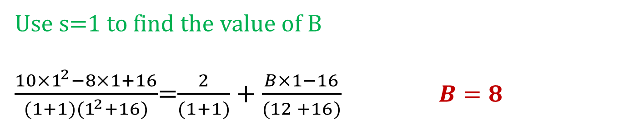
Use s=1 to find the value of B
$\frac{{10×1}^{2}−8×1+16}{(1+1)(1^{2}+16)}$=$\frac{2}{(1+1)}+\frac{B×1−16}{(12 +16)} B=8$
V_{in}(s) = $\frac{{10s}^{2}−8s+16}{(s+1)(s^{2}+16)}$=$\frac{2}{(s+1)}+\frac{8s−16}{(s^{2}+16)}=\frac{2}{(s+1)}+\frac{8s}{(s^{2}+16)}−\frac{16}{(s^{2}+16)}$
$Vin(t) = 2e^{−t}$ $u(t)+8cos⁡(4t)u(t)−4sin⁡(4t)u(t)$

Slide 14
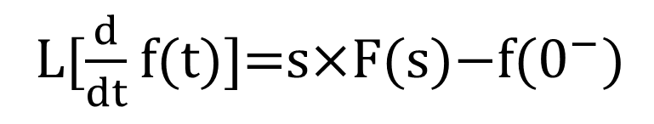
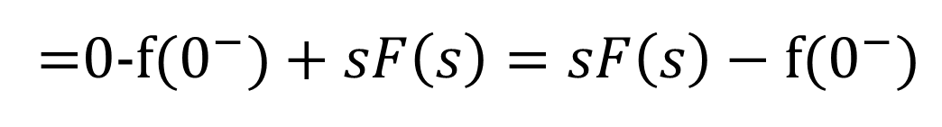
Time Differentiation Property
L[$\frac{d}{dt}$ f(t)]=s×F(s)$−$f($0^{−})$
Using the transformation equation and integration by parts
L[$\frac{d}{dt}$ f(t)]=$\int_{0^{−}}^{∞}{\left(\frac{d}{dt}f(t)\right)\text{e}\text{−}\text{s}\text{t} dt}={\left.\text{f}\text{(}\text{t}\text{) }\text{e}\text{−}\text{st}\right|}_{0^{− }}^{∞}−\int_{0^{−}}^{∞}{\left(−s\right)f(t) \text{e}\text{−}\text{st} dt}$
=0-f($0^{−})+sF\left(s\right)=sF\left(s\right)−\text{f}\text{(}0^{−})$
Differentiation in the time domain is equivalent to multiplication by s in the s-domain.

Slide 15
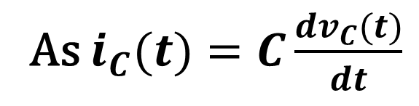

Example 12.23 (p. 581)
Find an expression for the current through the capacitor i_{c}(s) in the S domain.
As $i_{C}(t)=C\frac{{dv}_{C}(t)}{dt}$
Using the time differentiation property
$$I_{C}(s)=CsV_{c}\left(s\right)−Cv_{c}(0^{−})$$

Slide 16
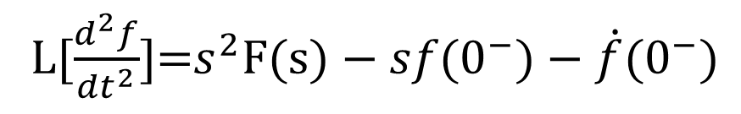
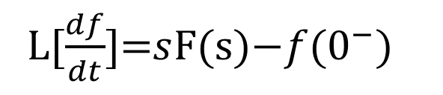
Time Differentiation Formula
L[$\frac{df}{dt}$]=$s$F(s)$−f$($0^{−})$
L[$\frac{d^{2}f}{{dt}^{2}}$]=$s^{2}\text{F}\text{(}\text{s}\text{)}−sf\text{(}0^{−})−\dot{f}\text{(}0^{−})$
L[$\frac{d^{n}f}{{dt}^{n}}$]=$s^{n}$×F(s)$−s^{n−1}×f$($0^{−})−s^{n−2}×\dot{f}\text{(}0^{−})−…f^{(n−1)}\text{(}0^{−})$

Slide 17
Example 4
Find the solution of the differential equation
Apply Laplace transform to the given equation
Solve for F(s)
Apply inverse Laplace Transform to obtain f(t)

Slide 18
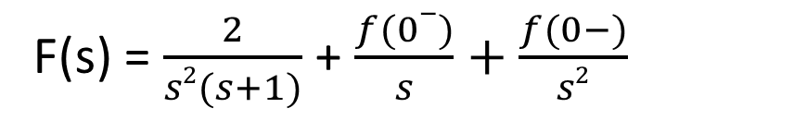
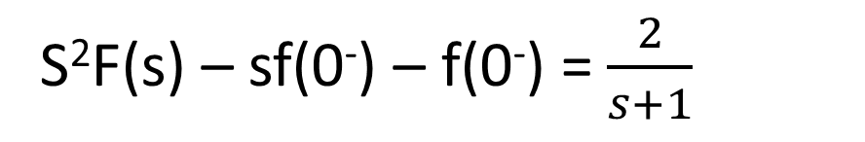
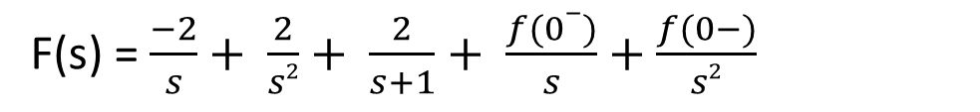
salman
Example 4
f(t) = 2e^{-t}u(t)
Find the solution of the differential equation
Apply Laplace transform to the given equation
S²F(s) – sf(0⁻) – f(0⁻) = $\frac{2}{s+1}$
Solve for F(s)
F(s) = $\frac{2}{s2(s+1)}$ + $\frac{f(0−)}{s}+\frac{f(0−)}{s2}$
F(s) = $\frac{−2}{s}+ \frac{2}{s2}+ \frac{2}{s+1}+ \frac{f(0−)}{s}+\frac{f(0−)}{s2}$
Apply inverse Laplace Transform to obtain f(t)
$$f\left(t\right)=−2u\left(t\right)+2tu\left(t\right)+2e−tu\left(t\right)+f\left(0−\right)u\left(t\right)+f\left(0−\right)tu(t)$$

Slide 19
Use AI and answer following questions
What is the purpose of using partial fraction expansions in circuit analysis?
How do you identify if a rational function F(s) has distinct or repeated poles from its denominator?
Given a function F(s) with distinct poles, describe the steps you would take to decompose it into partial fractions.
What changes in the decomposition process when you have repeated poles in F(s)F(s)F(s)? Provide an example.
After decomposing F(s), how is the inverse Laplace transform applied to find the corresponding time-domain function f(t)?

Slide 20
Summary
Purpose: Used to decompose a complex rational function F(s) into simpler terms for easier analysis in the time domain.
Key Steps:
Express F(s) in a form that can be expanded.
Use partial fraction decomposition for distinct and repeated poles.
Apply inverse Laplace transform to find f(t).
Application:
Finding time-domain solutions such as f(t) for circuits.
Suggested Additional Problems for Ch. 12:
Example 12.12 (p. 566), 12.13 (p. 567), 12.16 (p.574)
Exercises (p.567), (p.568), (p.575) ?
Example 12.17 (p. 576), 12.18 (p. 577), 12.21 (p. 580), 12.22 (p. 580),
Exercise (p. 577)?

